Slide 1




MONDAY AUTOMATION
TESTING PROJECT
Presented by: Mohammad Khayyo

Slide 2


About Me
23-year-old from Jerusalem
Graduated in Software engineering from the Azrieli College of Engineering Jerusalem
Enjoys hobbies such as traveling, and coding.

Slide 3
Table Of Content
1. Introduction to Monday.com
2. Project Documentation
3. The Code Overview
4. CI/CD with Jenkins
5. Project Management with Jira
6. Collaboration via Slack
7. Q&A

Slide 4
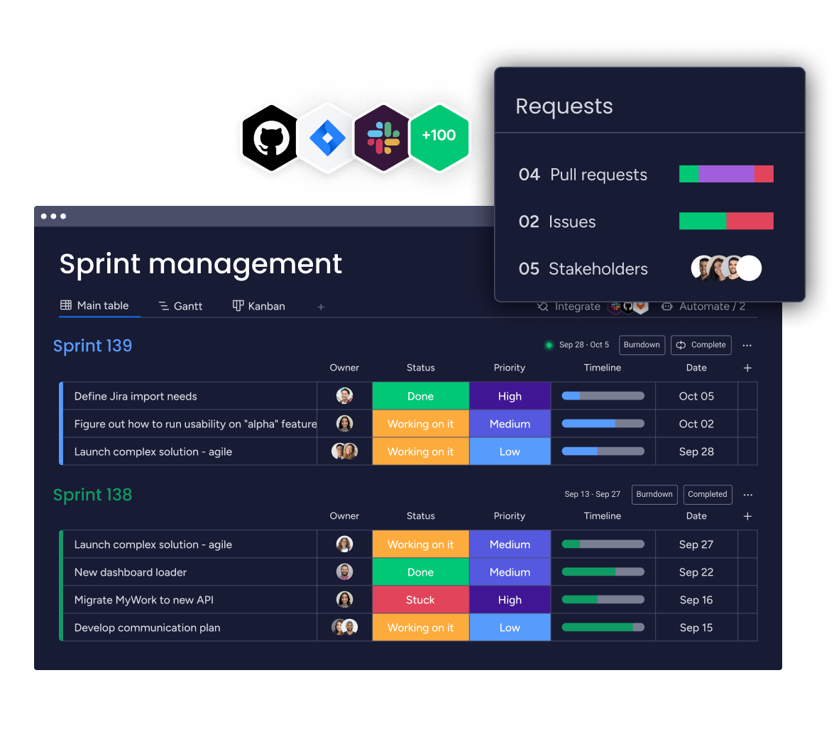
Introduction to Monday
A versatile Work OS that enables teams to manage projects and workflows with ease and efficiency.

Slide 5
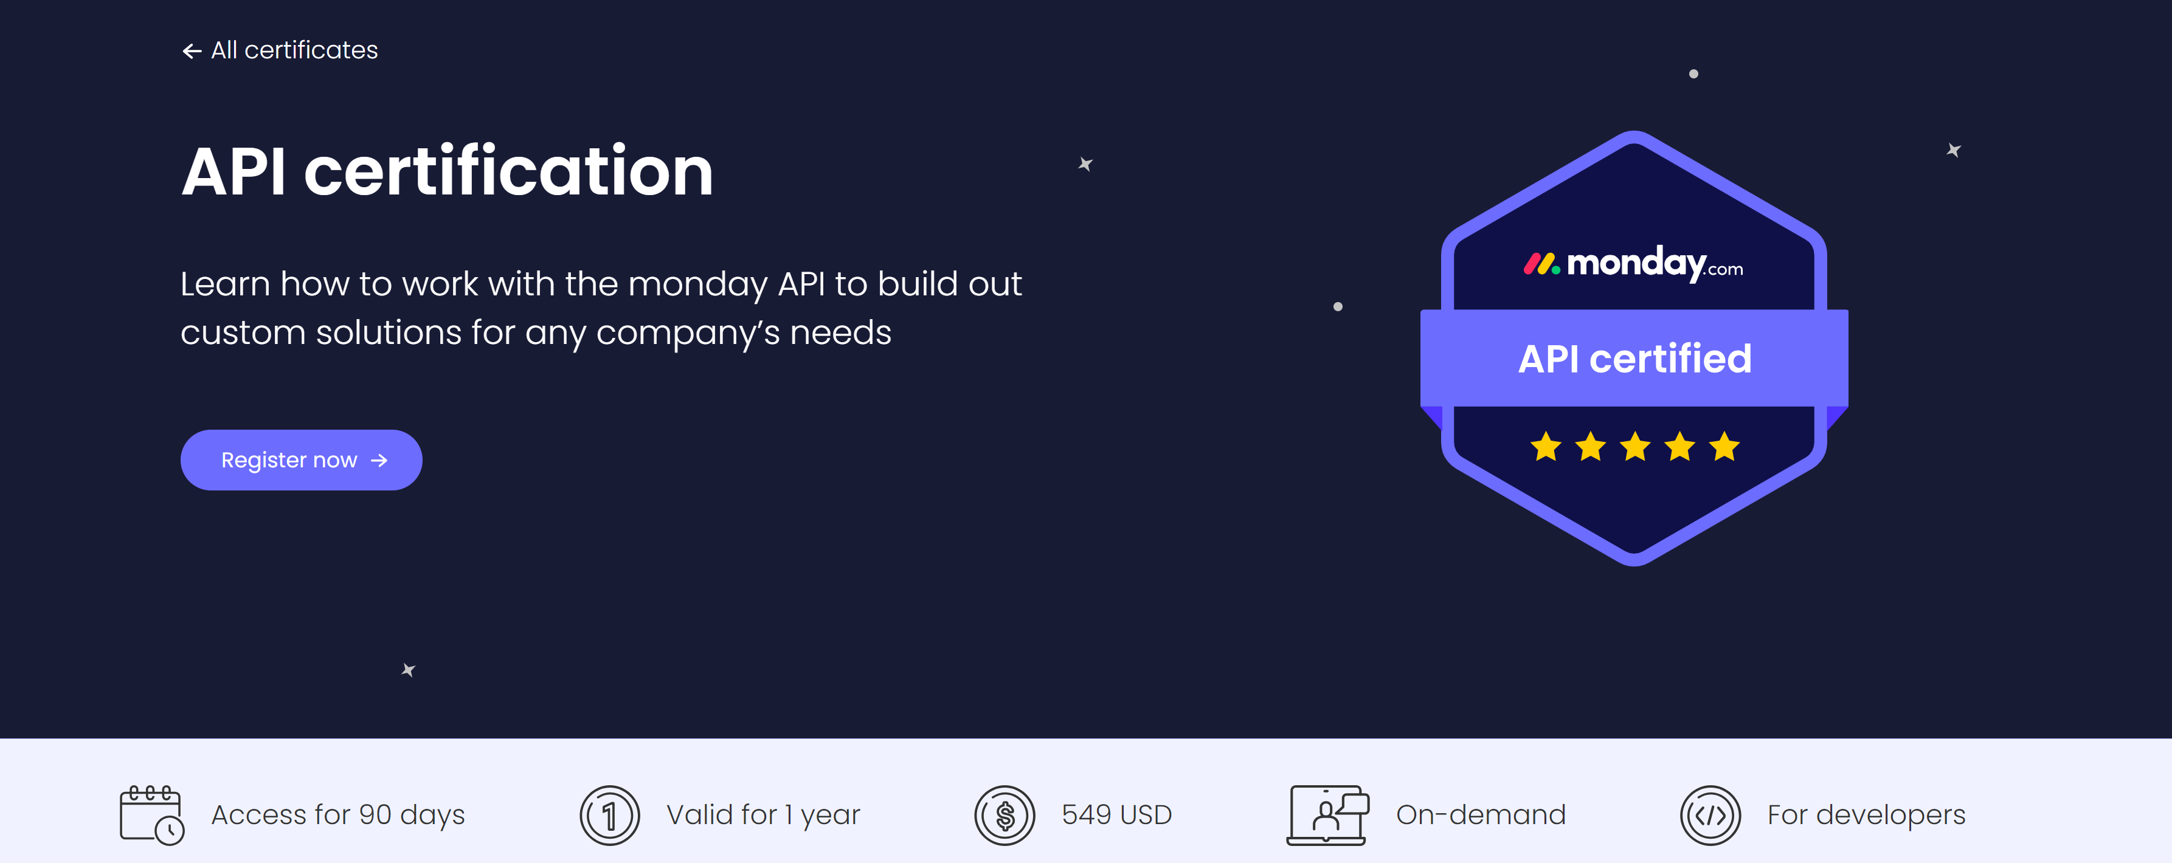
What is the Monday API?
The Monday API leverages GraphQL to provide developers with a robust and streamlined interface for interacting with Monday.com. This API facilitates precise data queries, updates, and real-time notifications, optimizing workflows and bolstering integrations for enhanced productivity.

Slide 6
Project Goals and Objectives
Our aim is to automate testing processes, reduce manual efforts, and increase efficiency.
To cover several types of tests: UI, API, and UI & API integrated tests.
To incorporate the term "CI/CD" into our tests.

Slide 7
STP
Software Test Plan: An overarching guide detailing the testing strategy, timeline, and resources.
STD
Software Test Description: Provides intricate details of each test case, including inputs and expected outcomes.

Slide 8
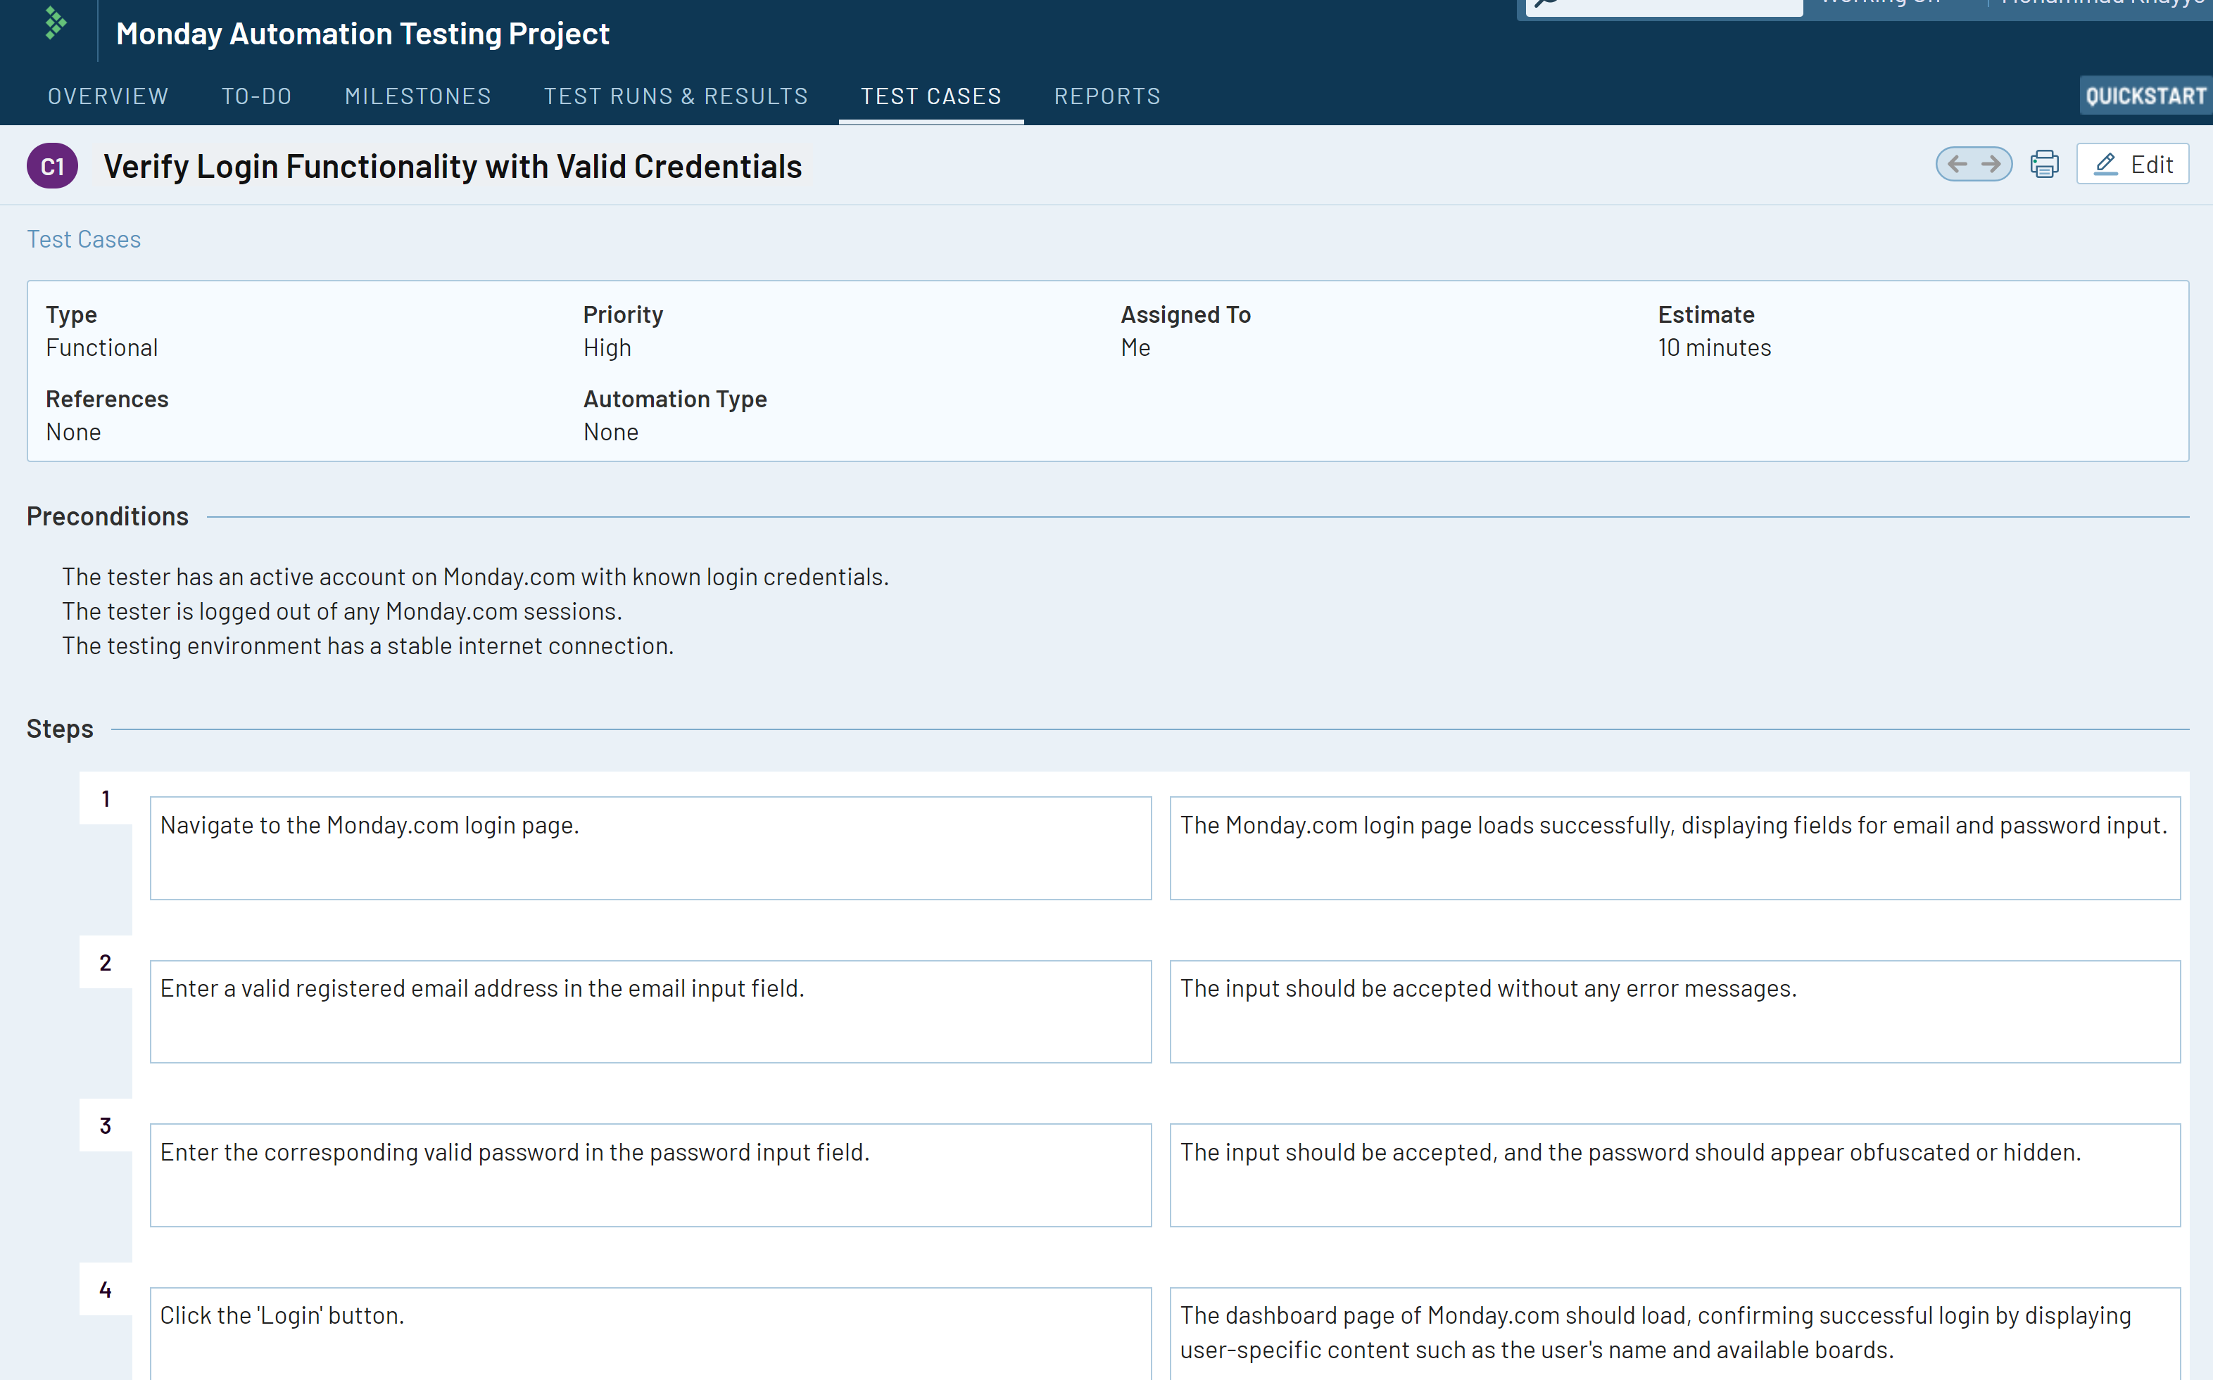
TestRail

Slide 9
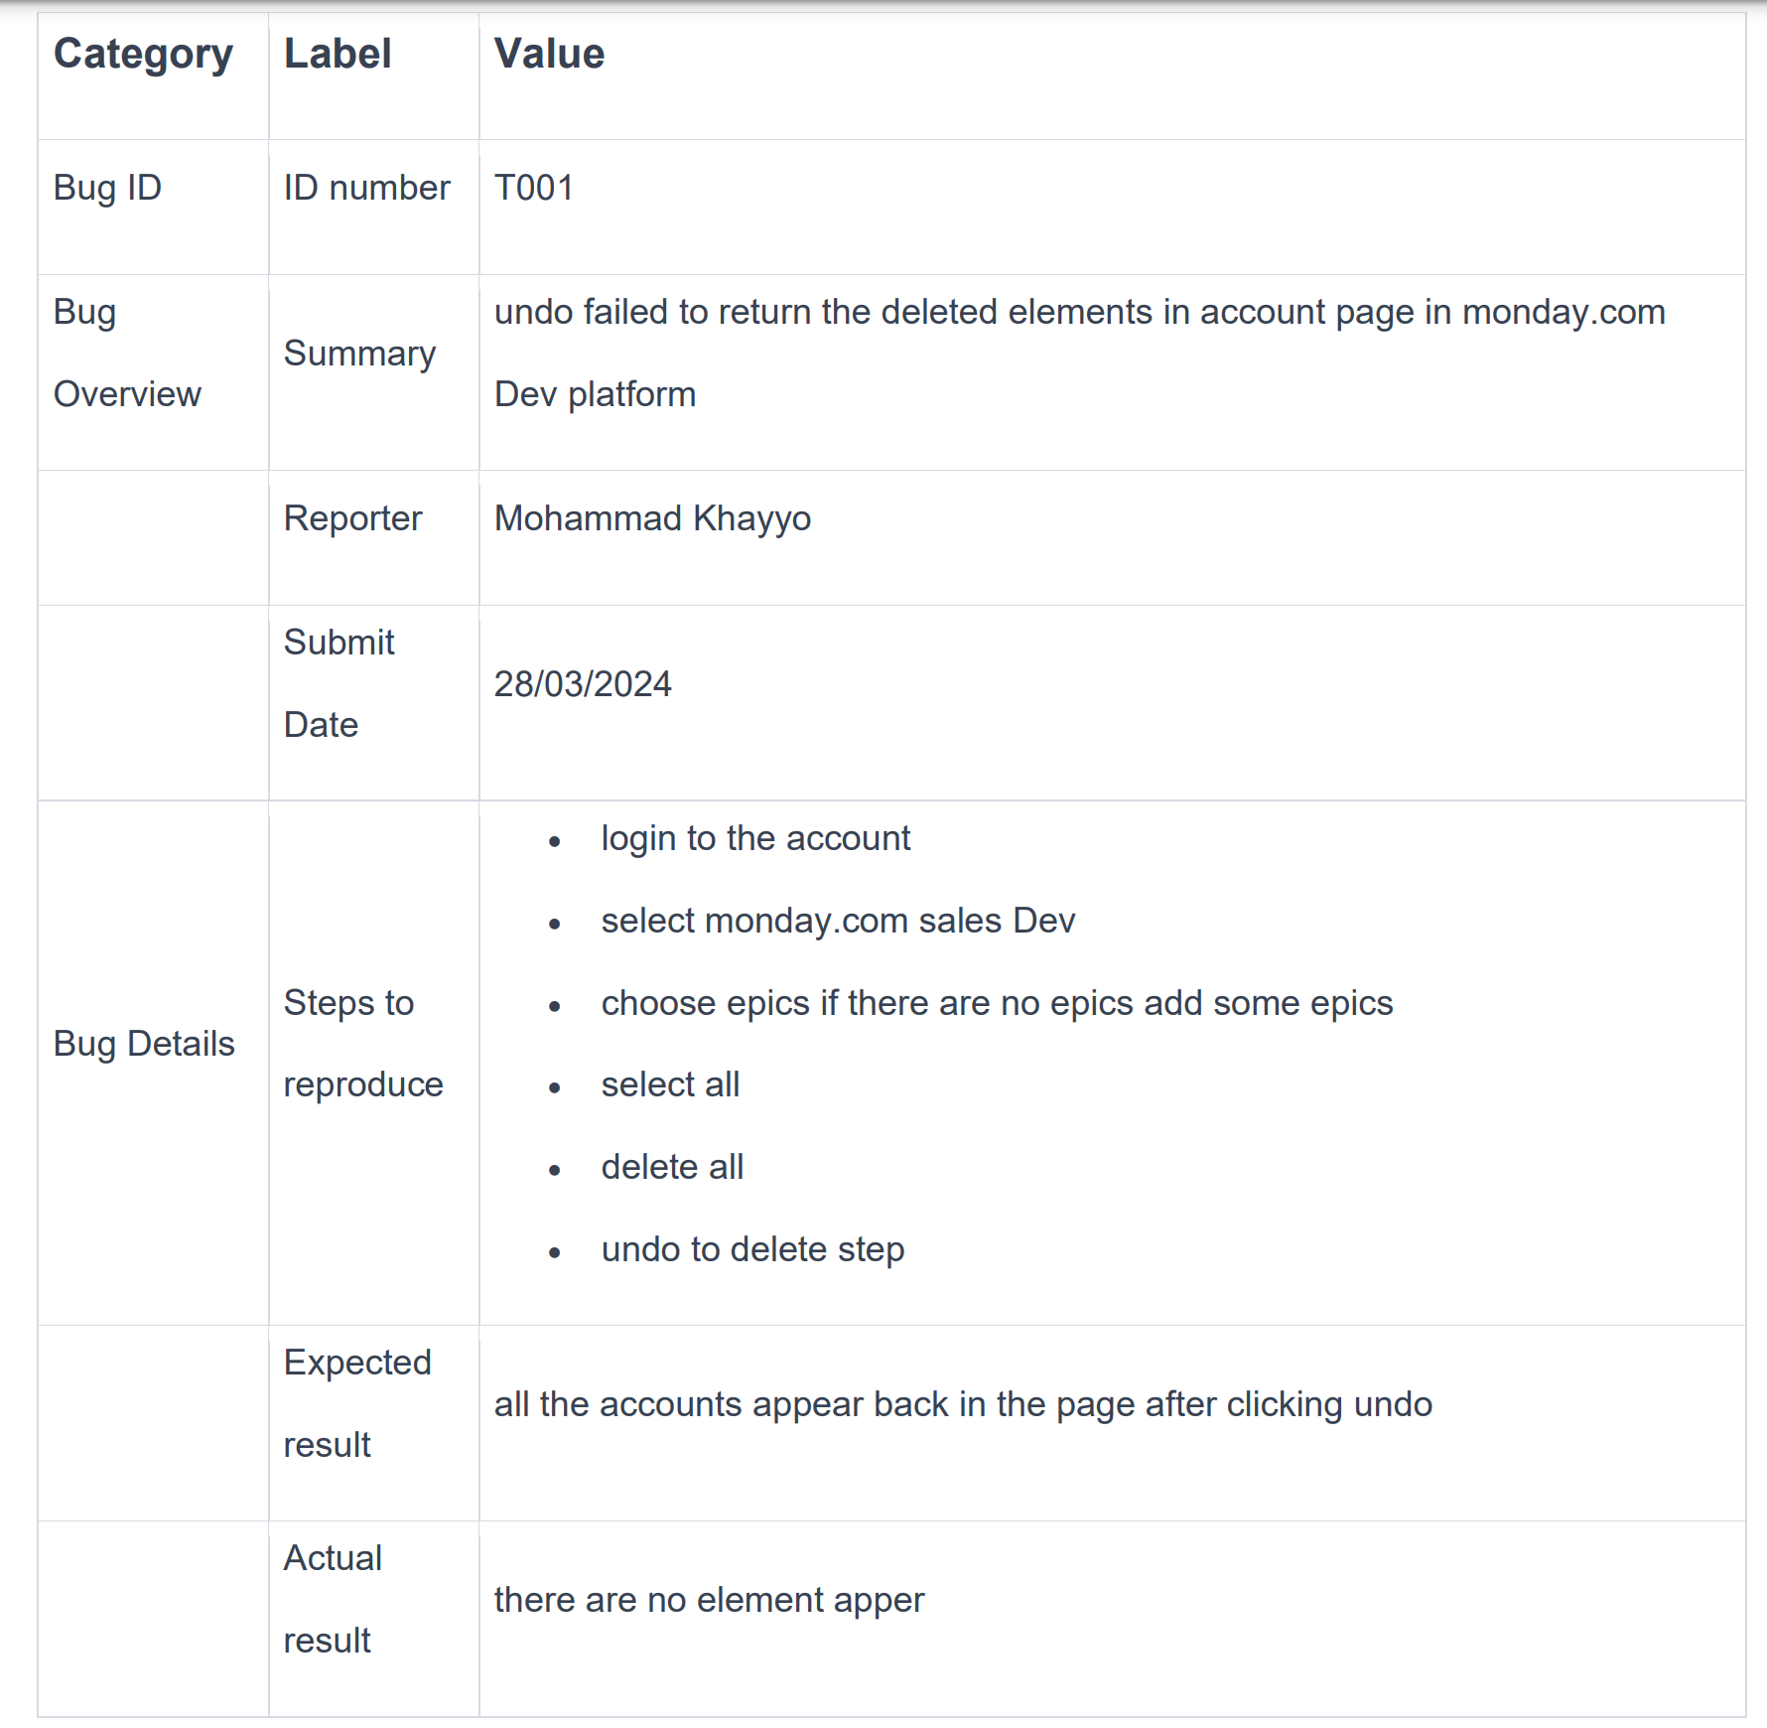
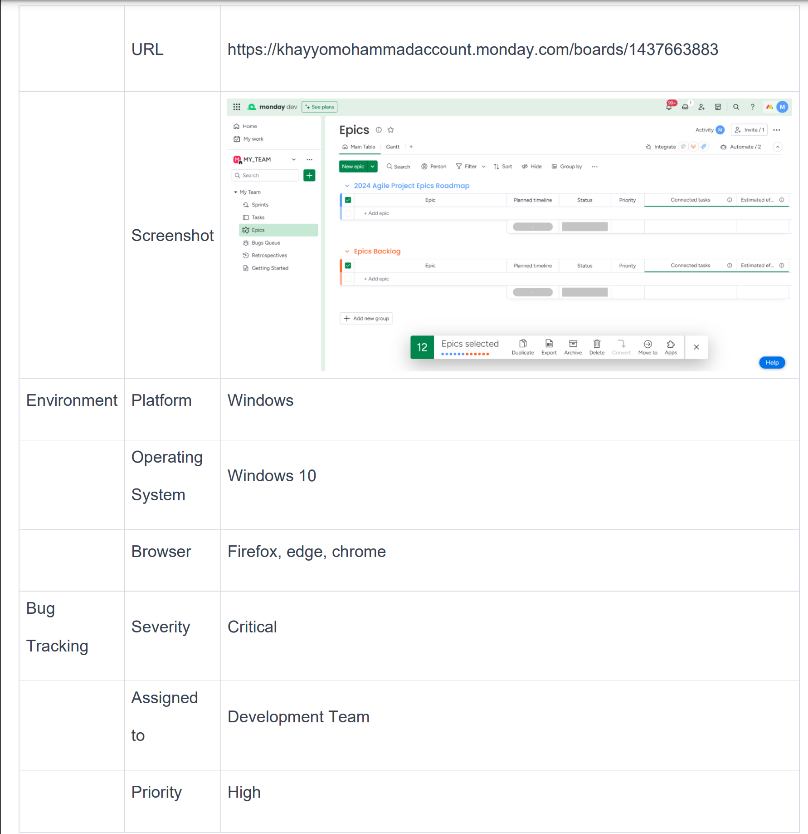
Bugs
Failed to retrieve the deleted epic using the UNDO button (UI test).
Bug Report :

Slide 10

What I Test?
E2E test
Positive / Negative tests
Functional and Non-Functional tests

Slide 11
What I Test?
Functional :
E2E test
Positive
Negative
Searching for a task that does not exist in the task table.
Non-Functional:
Capability
Performance:
Test how the system behaves under API request load.

Slide 12
UI & API Testing Strategies
We employ Selenium Grid for UI testing to ensure cross-browser compatibility and GraphQL queries for backend API validation to maintain integrity and performance.

Slide 13
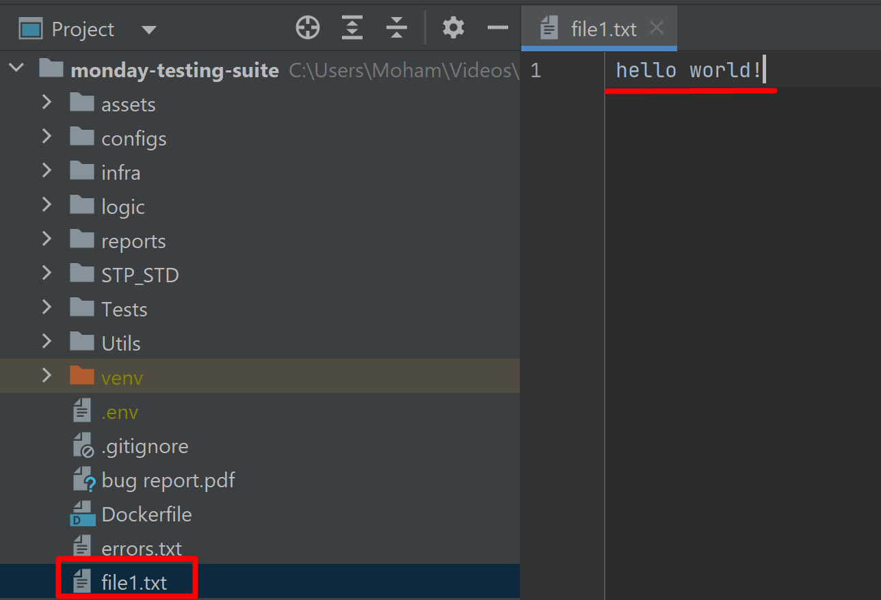
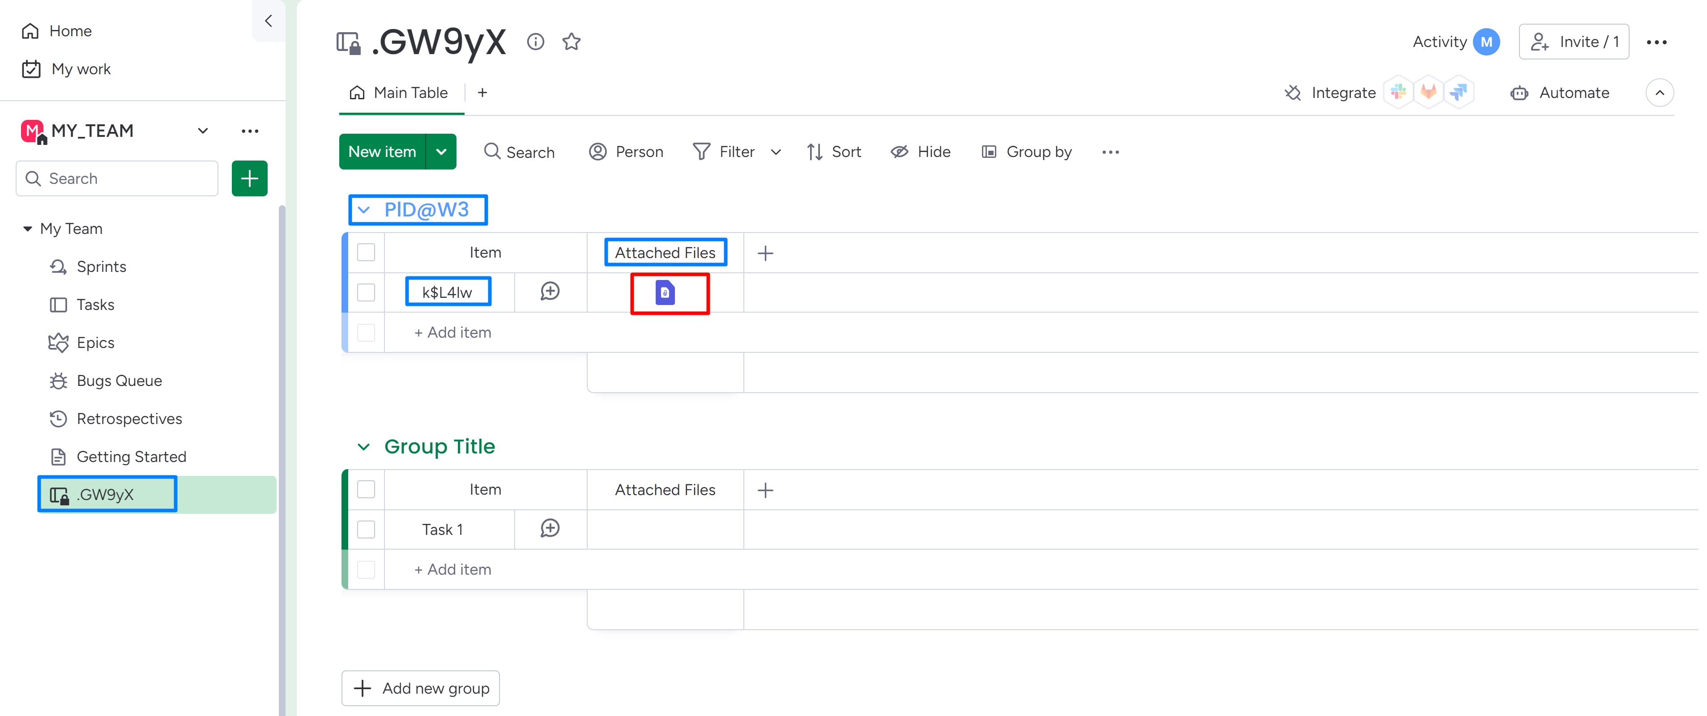
UI
API Testing

Slide 14
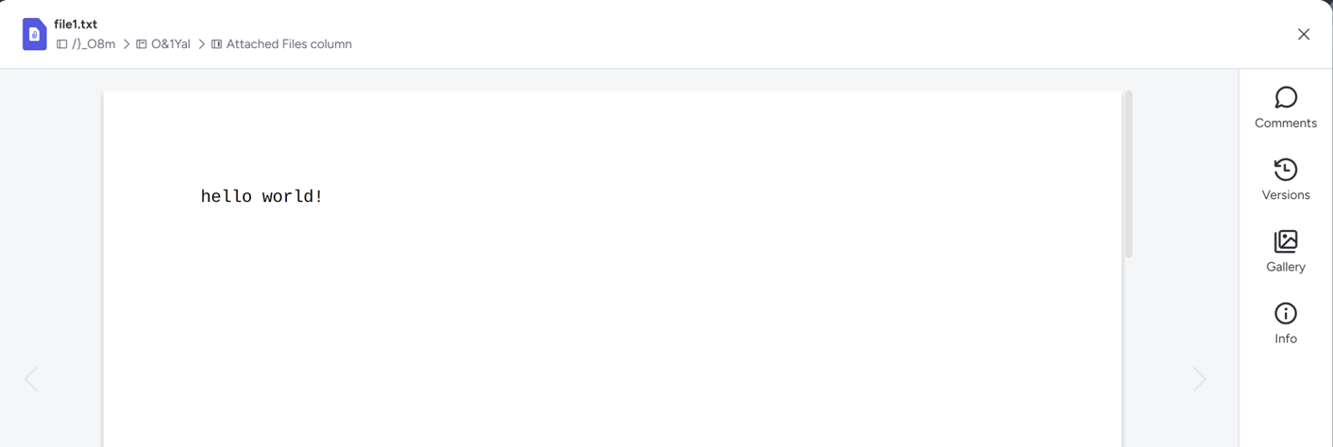
UI
UI Testing

Slide 15
Code OverView

Slide 16
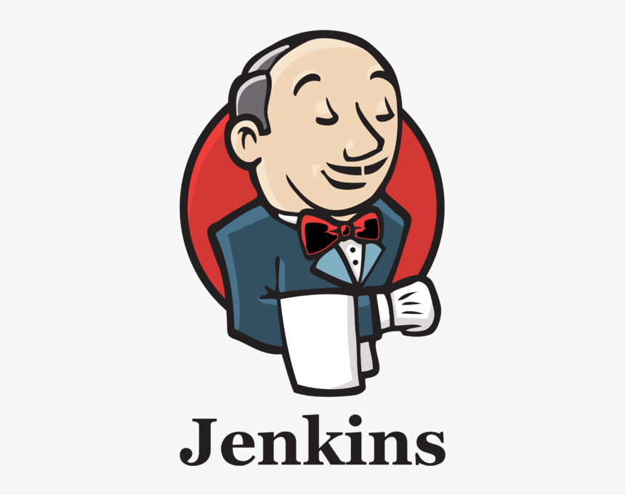
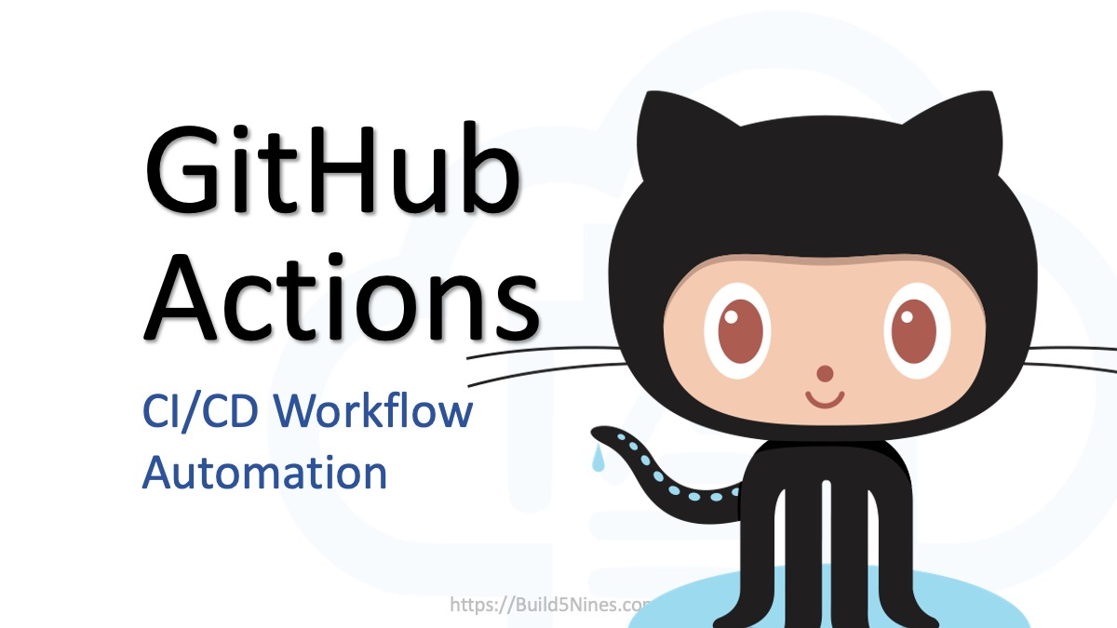
CI
Continuous Integration (CI) automates code merges, ensuring our software remains reliable and release-ready. Frequent integrations mean quick error detection and faster, more dependable delivery.

Slide 17
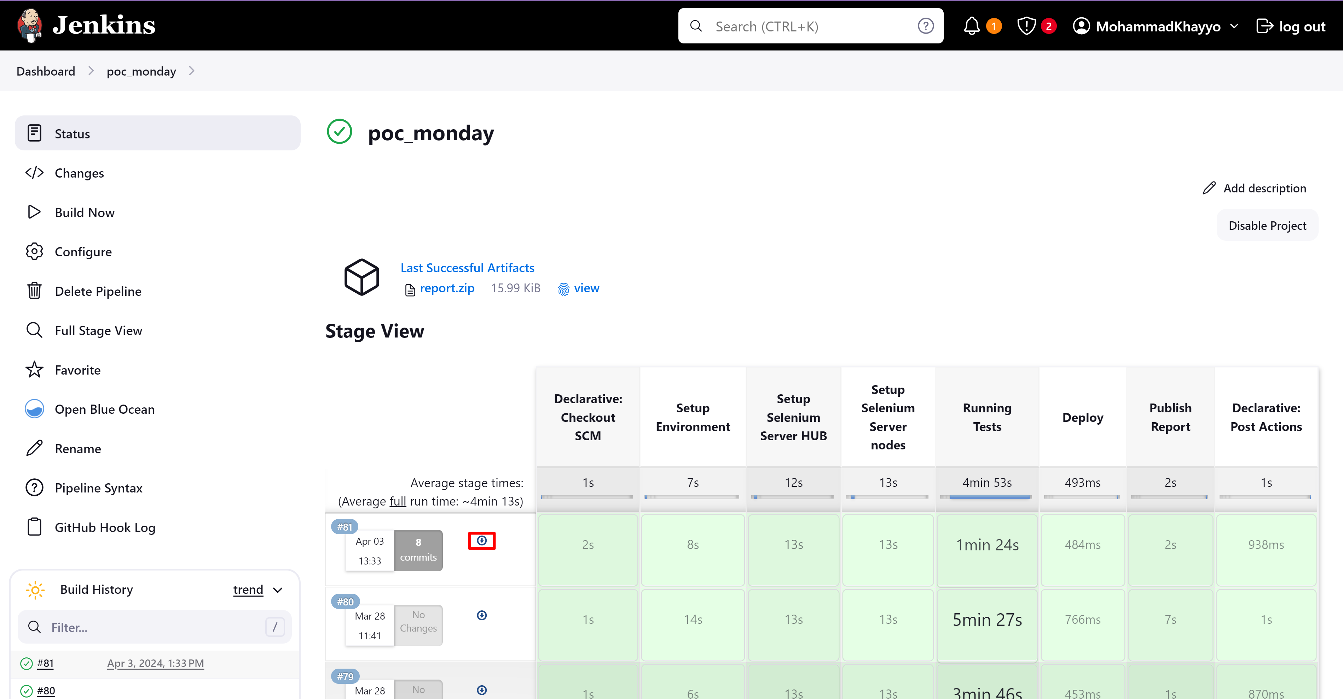
CI with Jenkins
Here are the Jenkins run results. I utilized it for the CI process, breaking down the pipeline into steps. Additionally, I incorporated the option to review a comprehensive test run report via the accessible button.

Slide 18
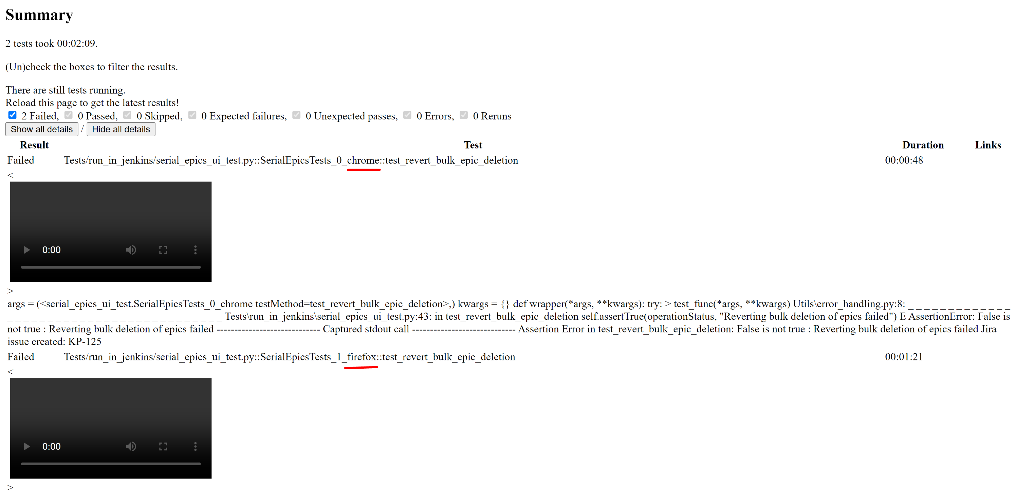
HTML Test Report

Slide 19
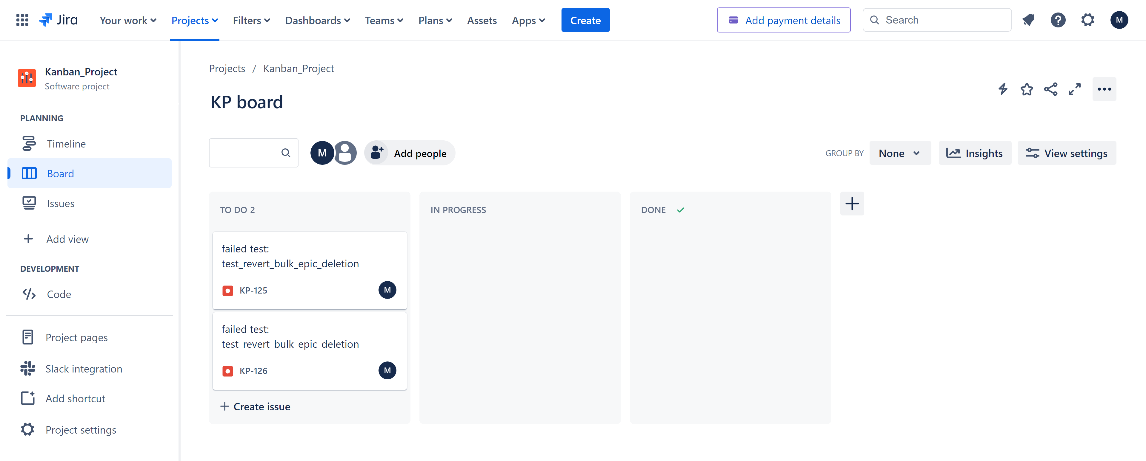
Jira
Jira is a popular project management tool used for issue tracking, agile project management, and workflow management.

Slide 20
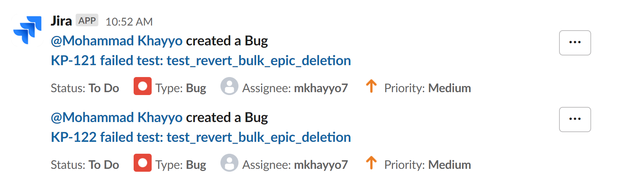
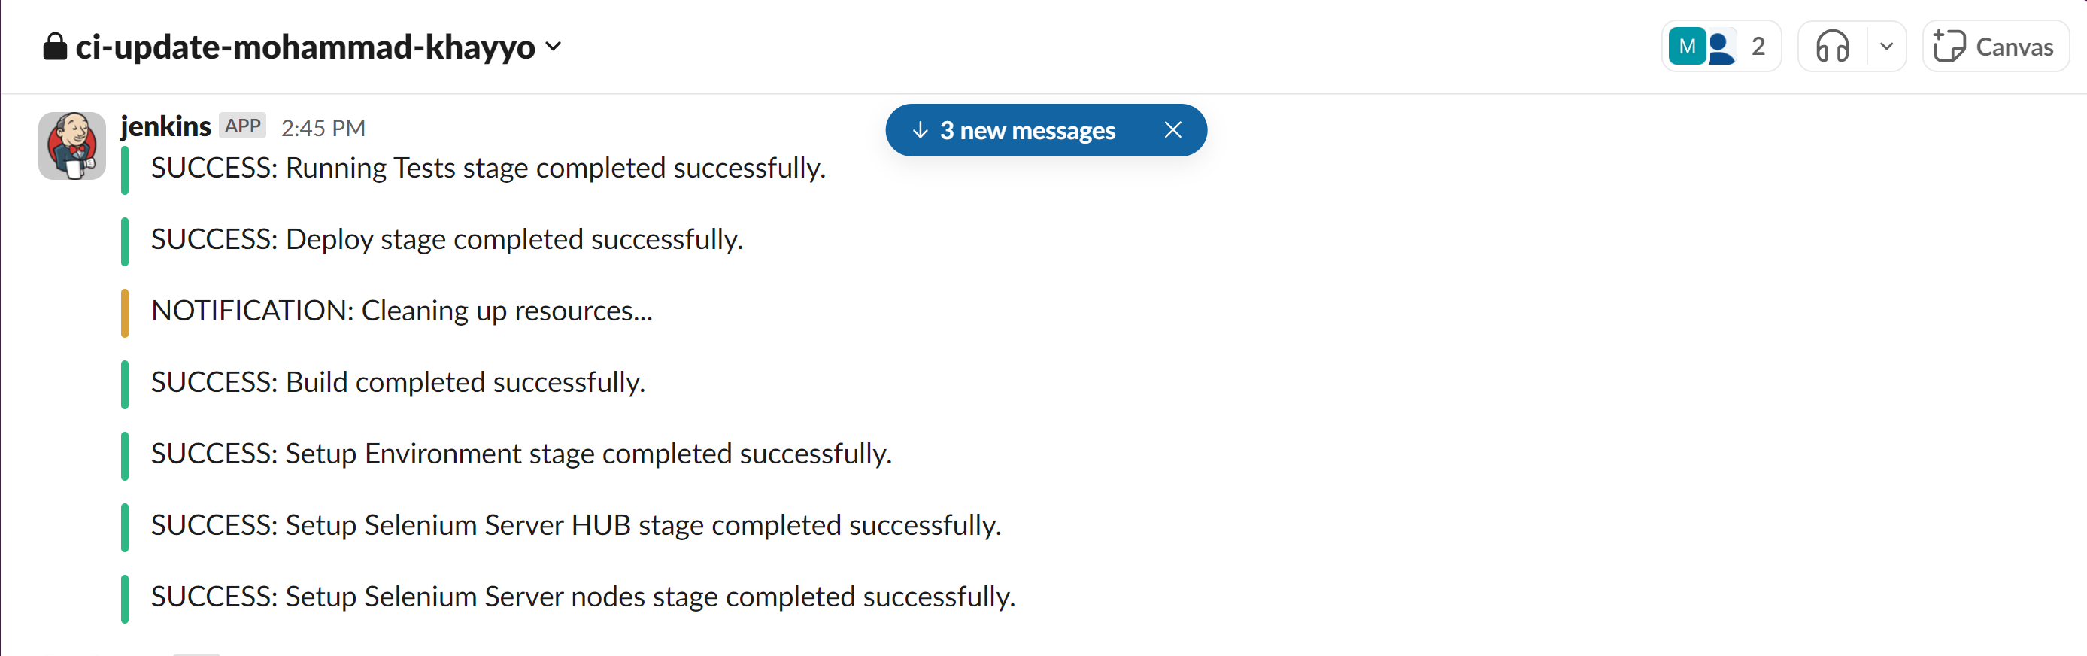
slack integration
Slack Integration

Slide 21
QUESTIONS

Slide 22




THANK YOU
For watching this presentation
+972-58-687-6306
mohammadkhayyo@gmail.com
github.com/MohammadKhayyo

